Slide 1
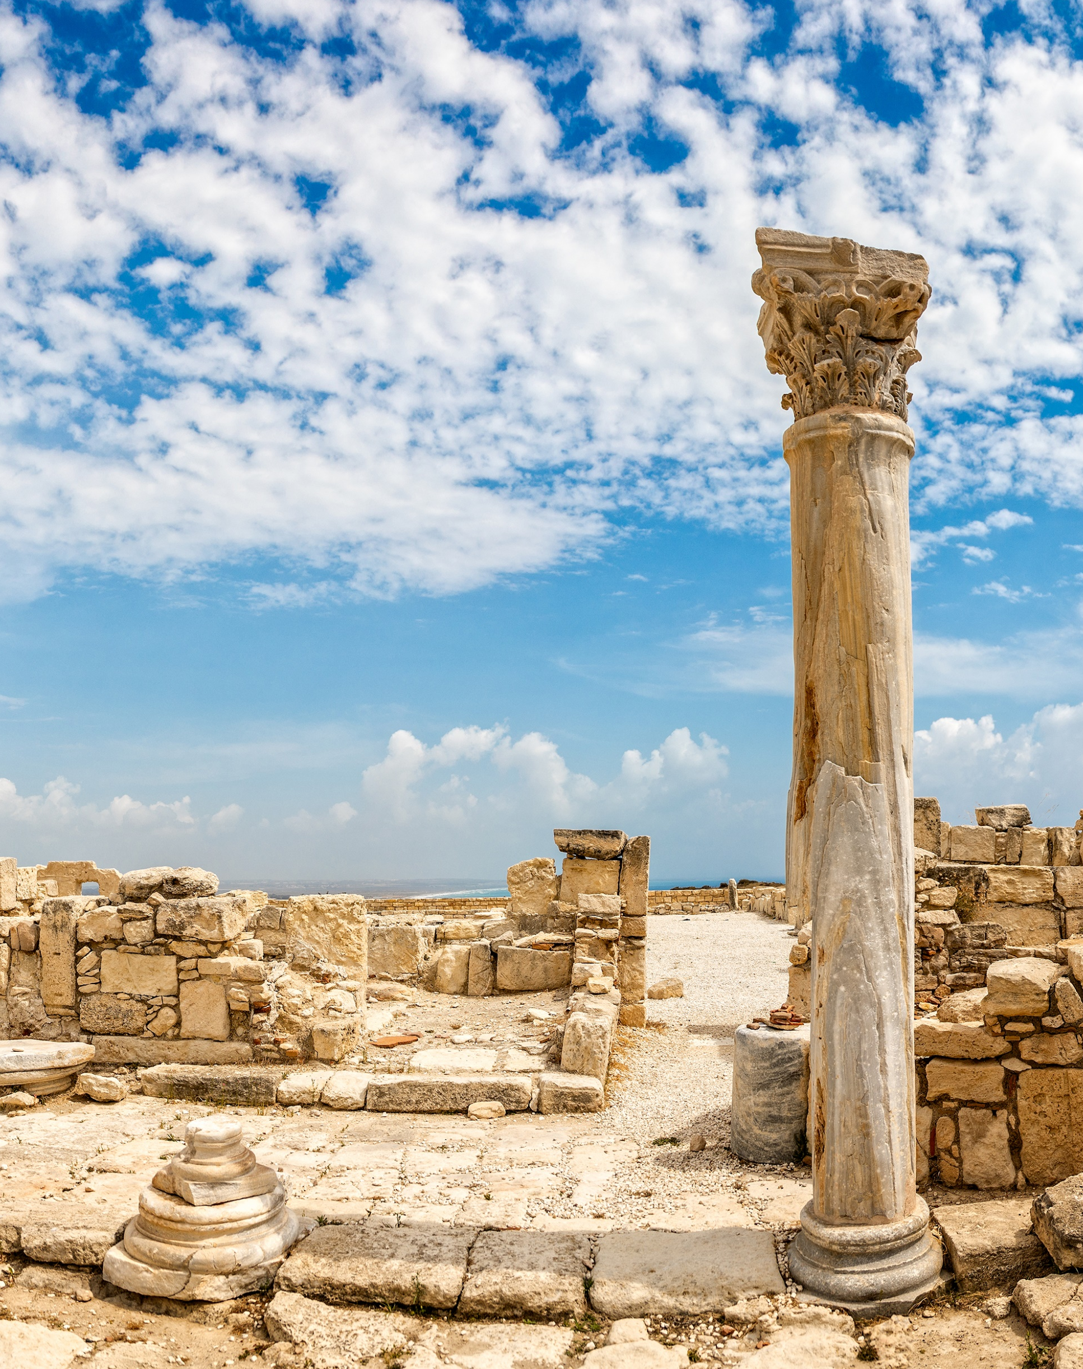

GALE IN CONTEXT:
MIDDLE SCHOOL
Ancient Civilizations Escape Room
1

Slide 2
TABLE OF CONTENTS
1 | Cover
2 | Table of Contents
3 | Escape Room Instructions and Tips
4-5 | Task Instructions and Arrangements
6 | Resource Access
7 | Printing Suggestions
8-9 | Group Answer Sheet
10-11 | Teacher Answer Key
12-17 | Task Answer Keys
18-21 | Description Cards for Stations or Folders
22-23 | Task 1: Mesopotamia
24-25 | Task 2: Ancient Egypt
26-27 | Task 3: Ancient India
28-29 | Task 4: Ancient China
30-31 | Task 5: Ancient Israel
32-34 | Task 6: Ancient Greece
35-37 | Task 7: Ancient Rome
38-39 | Task 8: Ancient Africa
40 | Citation Information
2

Slide 3
INSTRUCTIONS
BEFORE
Print and organize all necessary materials (see Printing Suggestions). Some stations consist of cut-and-sort activities. You can choose to have students cut these as they progress and then sort or, you can have them cut and placed in envelopes or folders before they begin.
Tasks can be set up as stations or as completion tasks where groups remain in one location. In either setup, it is important to have materials prepared that equal the number of groups. Having a folder/envelope for each task is best practice.
Gale resources should be accessed through the Gale In Context: Middle School database. (See Resource Access page).
DURING
Print Answer Keys and have them on hand to answer questions and aid as needed. Walk around the room and assist groups when necessary. Each time a group finishes a task, check their code to approve them to go onto the next one.
AFTER
Review reading material with students. This activity works well as an introduction to Ancient Civilizations, or as a culminating activity at the end of a unit. Students can reflect about what they learned during the activity with reflection writing or use what they learned as a starting point for a deeper research project.
3

Slide 4
TASK 1: Mesopotamia
Instructions: Students will read the assigned Gale resource and learn about Mesopotamia. Students will answer the questions that go with the article on their group answer key. All answers are one word except for the last one (written law). Each answer will have a highlighted letter, which is what will form their code.
Arrangements: There are 2 sets of questions per page to cut back on copies. See Resource Access to determine how you want to share reading materials with your students.
TASK 2: Ancient Egypt
Instructions: Students will use the hieroglyphics cipher tool to decode the answer for the fill-in-the-blank statements. They will record the clues on their group answer sheet. The correctly deciphered words will serve as their code.
Arrangements: It is recommended that you print a cipher for each student so that all students in the group can work together to decode.
TASK 3: Ancient India
Instructions: Students will read the assigned Gale resource and learn about Ancient India. They will then put the events in Ancient Indian history in the correct chronological order. Once in the correct order, the timeline will reveal the code which they will record on their group answer key.
Arrangements: The activity for this is a cut-and-sort activity. You can have students cut them and then sort or have them precut and stored in an envelope or bag. See Resource Access to determine how you want to share reading materials with your students.
TASK 4: Ancient China
Instructions: Students will read the assigned Gale resource and learn about Ancient China. They will then answer the multiple-choice questions. When questions are placed in order and answered correctly, this will reveal the code that they will record on the group answer key.
Arrangements: The questions for this are a cut-and-sort. You can have students cut them and then sort or have them precut and stored in an envelope or bag. See Resource Access to determine how you want to share reading materials with your students.
4

Slide 5
TASK 5: Ancient Israel
Instructions: Students will read the assigned Gale resource and learn about Ancient Israel. They will then complete the crossword puzzle. Highlighted boxes will reveal the code. Students will record code on group answer sheet.
Arrangements: Consider making extra copies of the puzzle so students can see the questions and work together. See Resource Access to determine how you want to share reading materials with your students.
TASK 6: Ancient Greece
Instructions: Students will access the images section on the Ancient Greece topic page via Gale in Context: Middle School. Students will match the image to the correct description. Matches will reveal the code. Students will record code on group answer sheet.
Arrangements: The activity for this is a cut-and-sort activity. You can have students cut them and then sort or have them precut and stored in an envelope or bag.
TASK 7: Ancient Rome
Instructions: Students will read the assigned Gale resource and learn about Julius Caesar. Students will use the biography on Roman leader, Julius Caesar, to complete his profile page. The final section is a quote, which they will use the pigpen cipher to decode. They will write the decoded quote on the group answer sheet. This will serve as their code.
Arrangements: Print enough ciphers for each student so they can all work together to answer the puzzle. See Resource Access to determine how you want to share reading materials with your students.
TASK 8: Ancient Africa
Instructions: Students will read the assigned Gale resource and learn about Ancient Africa. They will then match each question to the correct answer. It is recommended that students use a ruler for straight lines on the matching assignment. The letters that do not have a line through them at the end reveal the code, which is ghana. Straight lines are essential. See pg. 17 for an answer key.
Arrangements: This is a single answer sheet, so one sheet per group is recommended with students working together and assigning roles. For this one, it is recommended that one student use the ruler to match correct options to ensure lines are straight..
5

Slide 6
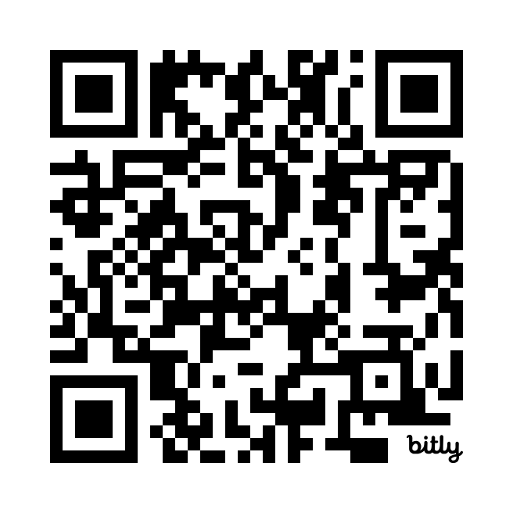
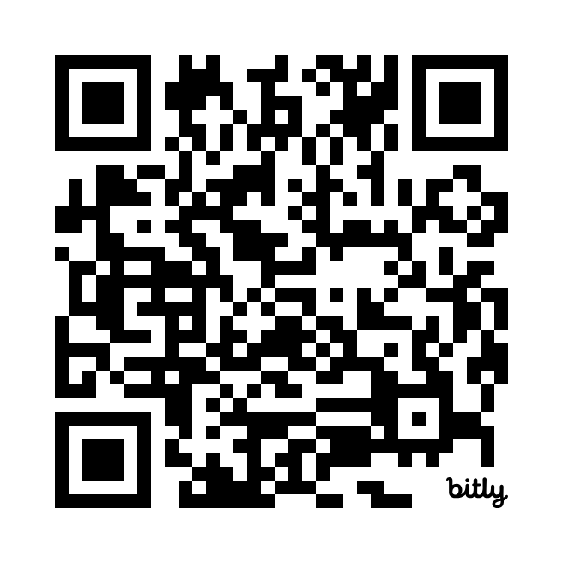
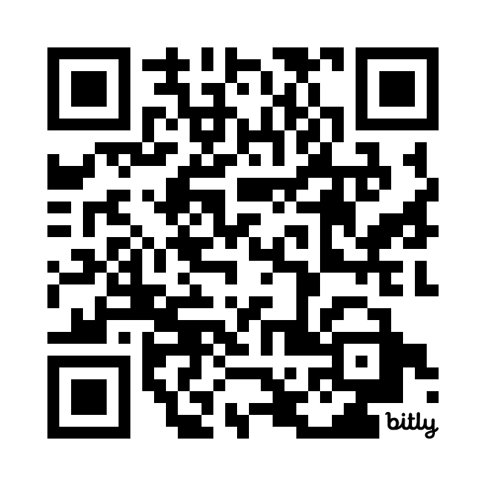
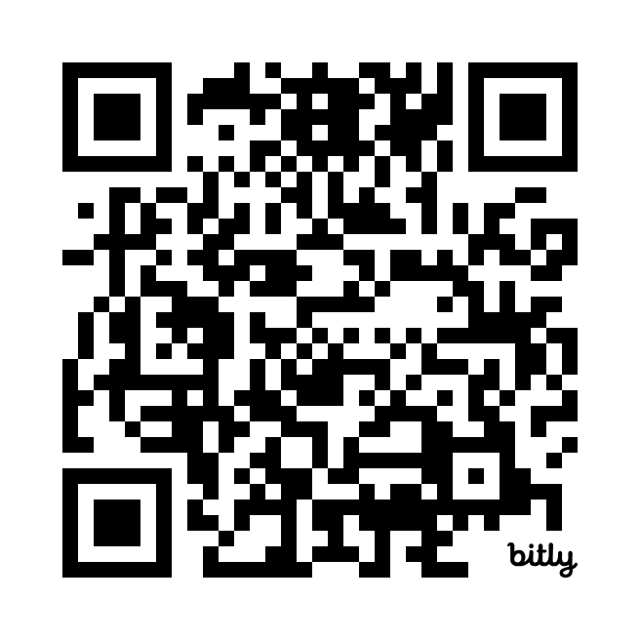
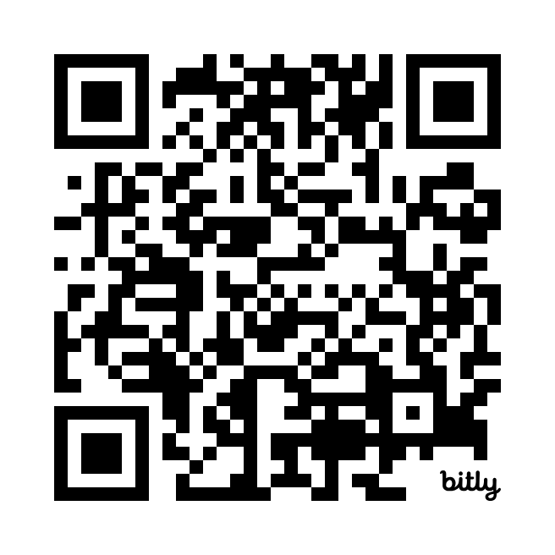
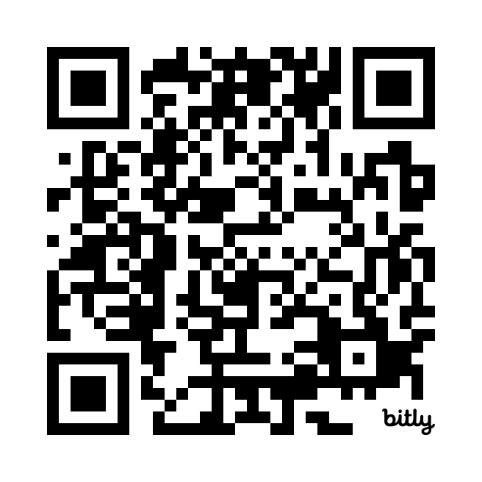
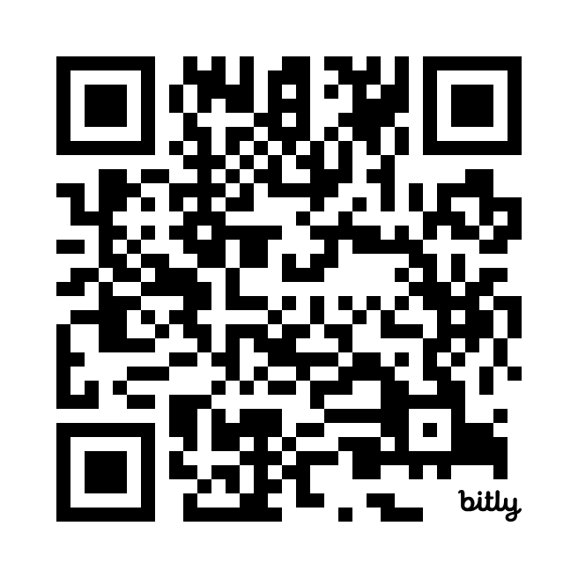
RESOURCE ACCESS
The best way to have students access task articles is to have them visit Gale In Context: Middle School and then open the links for each task using the links or QR codes below. They must open Gale In Context: Middle School prior to accessing the links below.
Task 1: Mesopotamia | https://link.gale.com/apps/doc/YTKUHM055839591/MSIC
Task 2: Ancient Egypt | https://link.gale.com/apps/doc/YMQNAY144176332/MSIC
Task 3: Ancient India | https://link.gale.com/apps/doc/OYXFIO592699449/MSIC
Task 4: Ancient China | https://link.gale.com/apps/doc/EBBFLB574881541/MSIC
Task 5: Ancient Israel | https://link.gale.com/apps/doc/WZPTUB069829912/MSIC
Task 6: Ancient Greece | Ancient Greece Topic Page → Images
Task 7: Ancient Rome | https://link.gale.com/apps/doc/JRXCFF963155011/MSIC
Task 8: Ancient Africa | https://link.gale.com/apps/doc/ZQQYHS680445161/MSIC
TASK1 | TASK 2 | TASK 3 | TASK 4
TASK 5 | TASK 6 | TASK 7 | TASK 8
Visit the topic page on Ancient Greece, then select Images.
6
Notes:
Students must access Gale In Context: Middle School PRIOR to opening the links or scanning QR codes.

Slide 7
PRINTING SUGGESTIONS
Pages 8-9 | One answer sheet per group
Pages 10-17 | Answer Keys for Teacher Use
Pages 18-21 | Description Cards for Stations or Folders (optional)
Page 22 | Task 1 direction cards (2 per page)
Page 23 | Task 1 questions (2 sets per page)
Page 24 | Task 2 directions and cipher
Page 25 | Task 2 hieroglyphics activity
Page 26 | Task 3 direction cards (2 per page)
Page 27 | Task 3 questions (cut-and-sort)
Page 28 | Task 4 direction cards (2 per page)
Page 29 | Task 4 questions (cut-and-sort)
Page 30 | Task 5 direction cards (2 per page)
Page 31 | Task 5 crossword
Page 32 | Task 6 direction cards (2 per page)
Page 33-34 | Task 6 photo sort
Page 35 | Task 7 direction cards (2 per page)
Page 36 | Task 7 biography activity
Page 37 | Pigpen Cipher for biography (2 per page)
Page 38 | Task 8 direction cards (2 per page)
Page 39 | Task 8 questions (cut-and-sort)
7

Slide 8

Group
Answer
Sheet
Gale In Context: Middle School
Ancient Civilizations Escape Room
Group Members:
TASK 1
1.
2.
3.
4.
5.
6.
7.
CODE WORD
TASK 2
TASK 3
1.
2.
3.
4.
5.
6.
TASK 4
_____ _____ _____ _____ _____ _____ ____
TASK 5
_____ ______ ______ ______ ______ ______ ______ ______ ______ ______ ______ _____
1 2 3 4 5 6 7 8 9 10 11 12
8

Slide 9

TASK 6
___________ ___________ ___________ ___________ ___________ ___________ ___________ ___________
1 2 3 4 5 6 7 8
TASK 7
“_______________________________________________,
________________________________________________,
_______________________________________________.”
- Julius Caesar
TASK 8
Secret Code Word: ___________________________________________
NOTES
YOU
ESCAPED!
9

Slide 10
ANSWER
KEY
Gale In Context: Middle School
Ancient Civilizations Escape Room
Group Members:
TASK 1
1. | A | G | R | I | C | U | L | T | U | R | E
2. | U | R | U | K
3. | W | H | E | E | L
4. | C | U | N | E | I | F | O | R | M
5. | G | I | L | G | A | M | E | S | H
6. | S | A | R | G | O | N
7. | W | R | I | T | T | E | N | L | A | W
CODE | G | K | W | N | E | O | W
TASK 2
TASK 3
1. Pharaohs
2. Nile
3. Pyramids
4. mummification
5. Giza
6. Alexander
7 | 3 | 6 | 1 | 8 | 2 | 5 | 4
TASK 4
__A__ __N__ __C__ __I__ __E__ __N__ __T__
TASK 5
__J__ __U__ __J__ __G__ __P__ __N__ __P__ __M__ __A__ __R__ __R__ __A__
1 2 3 4 5 6 7 8 9 10 11 12
10

Slide 11
ANSWER KEY
TASK 6
___D___ ___F___ ___G___ ___H___ ___C___ ___E___ ___A___ ___B___
1 2 3 4 5 6 7 8
TASK 7
“_I CAME__________________________,
__I SAW___________________________,
__I CONQUERED__________________.”
- Julius Caesar
TASK 8
Secret Code Word: _GHANA________________________________
NOTES
YOU
ESCAPED!
11

Slide 12
TASK 1
ANSWER KEY
The societies in Mesopotamia were among the earliest to adopt what? AGRICULTURE
What was the name of the oldest city in the world? URUK
What item did the Sumerians invent? WHEEL
What was the name of the written language Sumerians created and used? CUNEIFORM
What is known as the “oldest surviving written story”? GILGAMESH
What Akkadian leader decided that his power would be passed to his children after death? SARGON
Babylon’s leader, King Hammurabi, wrote one of the oldest known forms of what? WRITTEN LAW
TASK 2
ANSWER KEY
For most of its history, Ancient Egypt was ruled by PHARAOHS who were thought of as gods in human form.
Much of the civilization was based along the fertile plains of the NILE River.
Most historians believe the PYRAMIDS were built to serve as tombs for the Pharaohs.
The bodies of important people were preserved after death so they would retain a lifelike appearance. This process was known as MUMMIFICATION.
The Great Pyramid at GIZA is the largest pyramid and one of the Seven Wonders of the Ancient World.
Ancient Egypt went into decline after being conquered by ALEXANDER the Great in 332 BC.
12

Slide 13
TASK 3
ANSWER KEY
Farmers first started growing crops near the banks of the Indus River
7
People who lived in Indus Valley villages learned to make metal tools and other goods that they traded.
3
The planned cities of Mohenjo-Daro and Harappa were formed.
6
The Indus Valley civilization was hit by a series of earthquakes that disrupted life there and may have forced many people to flee.
1
Aryans made their way into the region starting the Vedic Period.
8
The caste system was implemented which divided ancient Indian society into four main classes—the Brahmin, Kshatriya, Vaisya, and Sudra castes.
2
An increasing number of religious reformers broke away from Hinduism to create other religions like Buddhism and Jainism.
5
The Gupta Empire came to rise in 320 AD. During the Gupta Empire, India entered a golden era, during which the arts and sciences flourished.
4
TASK 4
ANSWER KEY
1. China is named after which dynasty? A. QIN
2. The 1987 movie The Last Emperor was based on the life of which Chinese emperor? N. PUYI
3. Who was said to have invented the Chinese calendar and Chinese writing? C. HUANGDI
4. What was the name of the great royal palace built during the Ming dynasty? I. THE FORBIDDEN CITY
5. China became the richest nation on Earth during which period? E. THE GOLDEN AGE
6. The Chinese developed an idea that the country’s kings were the “sons” of heaven. Events were treated as a sign the gods were either pleased or unhappy with the king. What was this known as? N. MANDATE OF HEAVEN
7. During which time did China begin to do away with slavery and change to a system of landowners and servants.? T. ZHOU
13

Slide 14
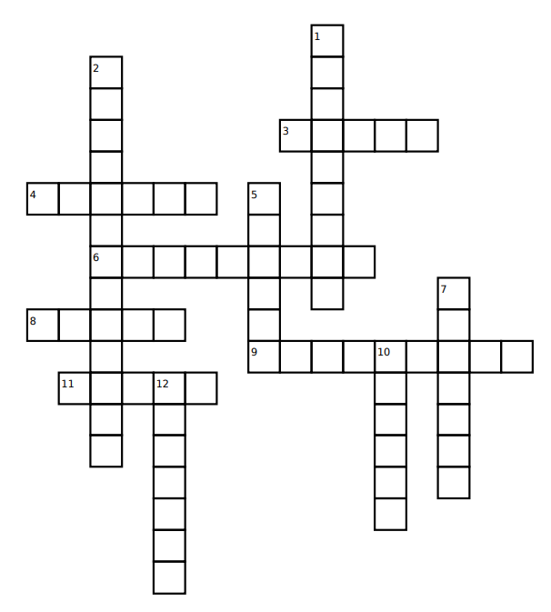
TASK 5
ANSWER KEY
J
E
R
U
S
A
L
E
M
U
N
I
T
E
D
N
A
T
I
O
N
S
J D A H
G R E C E
P
E
R
S
I
E W J E S Y
P
L
A
G
U
E
S
M Y H S
R
O
M
A
N
S
A S S Y I N S
R M N
A
B
R
A
H
A
M
14

Slide 15
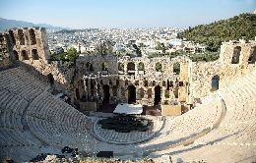
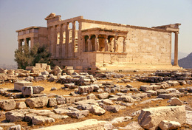
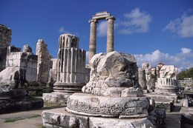
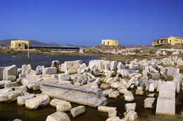
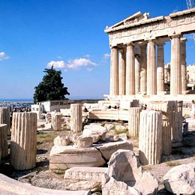
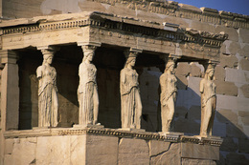
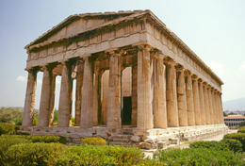
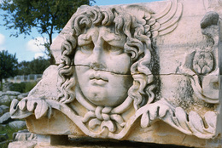
TASK 6
ANSWER KEY
1
The
Acropolis
5
Temple
of Athena
D
C
2
Temple
of Apollo
6
Ruins at
Delos
F
E
3
The
Parthenon
7
Porch of
the
Caryatids
G
A
8
The
Agora
B
4
Medusa
Frieze
H
___D___ ___F___ ___G___ ___H___ ___C___ ___E___ ___A___ ___B___
1 2 3 4 5 6 7 8
15

Slide 16
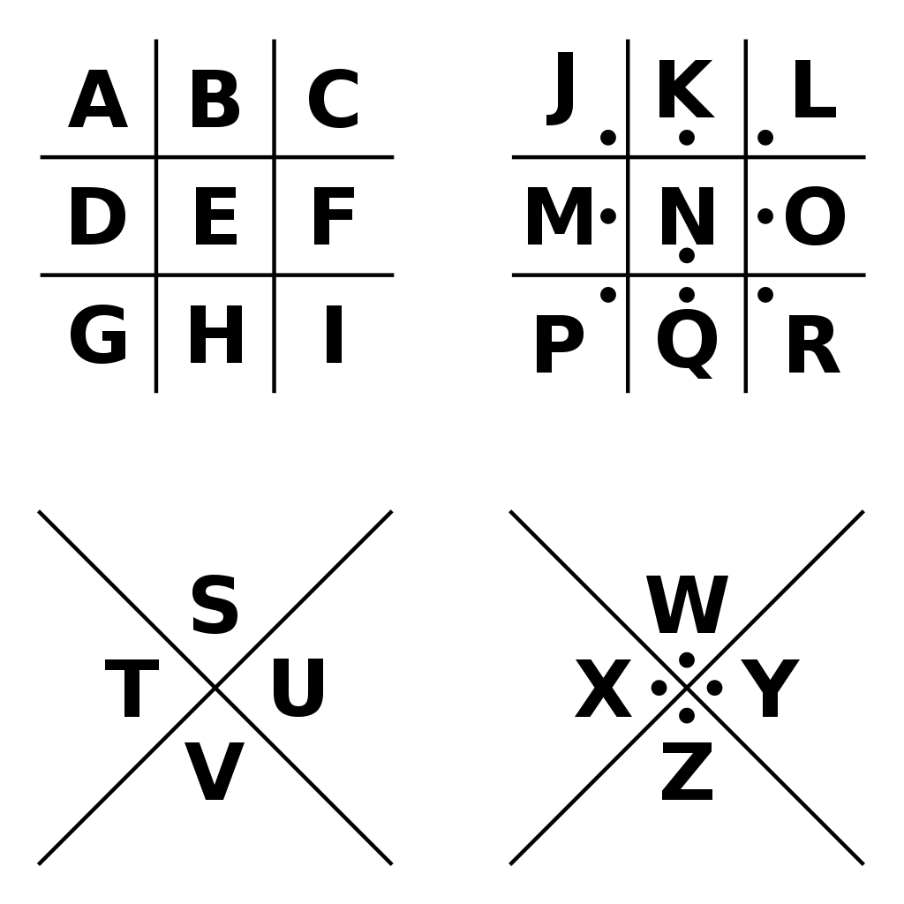













TASK 7
ANSWER KEY
I CAME
I SAW
I CONQUERED
16

Slide 17
TASK 8
ANSWER KEY
Correctly match each question with its answer by drawing a line to connect them (use the dots!). At the end, the letters with no line through them will reveal your code.
Tip – use a ruler to get extra straight lines!
Sundiata Keita | • |  | • | This region was created after a climate change in northern Africa
Carthage | • |  | • | People could stay in one place instead of being nomadic
Epic of Sundiata | • |  | • | One of the first kingdoms in the world to accept the religion of Christianity
The Sahara Desert | • |  | • | Known as the Lion King
Aksum | • |  | • | A powerful civilization with its capital city in modern-day Tunisia.
Domestication of Animals | • |  | • | One of the oldest-known works of African literature
S
G
H
C
E
A
O
Y
N
S
A
R
17

Slide 18
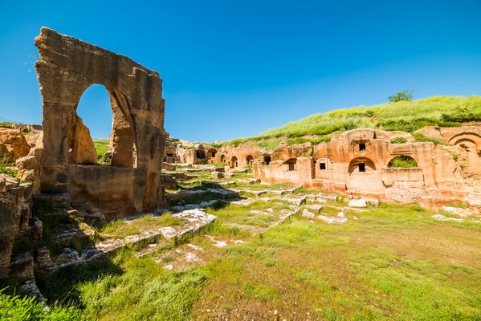
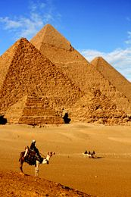
TASK 1
TASK 1
Use the Task 1 resources to complete your task and crack the code! Be sure to record answers on our group answer sheet.
Use the Task 1 resources to complete your task and crack the code! Be sure to record answers on our group answer sheet.
MESOPOTAMIA
MESOPOTAMIA
TASK 2
TASK 2
Use the Task 2 resources to complete your task and crack the code! Be sure to record answers on our group answer sheet.
Use the Task 2 resources to complete your task and crack the code! Be sure to record answers on our group answer sheet.
ANCIENT EGYPT
ANCIENT EGYPT
18

Slide 19
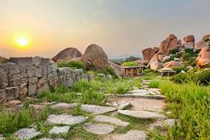
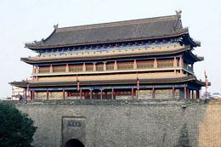
TASK 3
TASK 3
Use the Task 3 resources to complete your task and crack the code! Be sure to record answers on our group answer sheet.
Use the Task 3 resources to complete your task and crack the code! Be sure to record answers on our group answer sheet.
ANCIENT INDIA
ANCIENT INDIA
TASK 4
TASK 4
Use the Task 4 resources to complete your task and crack the code! Be sure to record answers on our group answer sheet.
Use the Task 4 resources to complete your task and crack the code! Be sure to record answers on our group answer sheet.
ANCIENT CHINA
ANCIENT CHINA
19

Slide 20
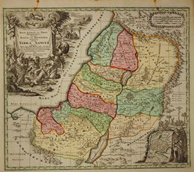
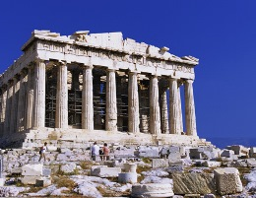
TASK 5
TASK 5
Use the Task 5 resources to complete your task and crack the code! Be sure to record answers on our group answer sheet.
Use the Task 5 resources to complete your task and crack the code! Be sure to record answers on our group answer sheet.
ANCIENT ISRAEL
ANCIENT ISRAEL
TASK 6
TASK 6
Use the Task 6 resources to complete your task and crack the code! Be sure to record answers on our group answer sheet.
Use the Task 6 resources to complete your task and crack the code! Be sure to record answers on our group answer sheet.
ANCIENT GREECE
ANCIENT GREECE
20

Slide 21
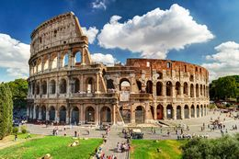
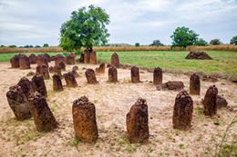
TASK 7
TASK 7
Use the Task 7 resources to complete your task and crack the code! Be sure to record answers on our group answer sheet.
Use the Task 7 resources to complete your task and crack the code! Be sure to record answers on our group answer sheet.
ANCIENT ROME
ANCIENT ROME
TASK 8
TASK 8
Use the Task 8 resources to complete your task and crack the code! Be sure to record answers on our group answer sheet.
Use the Task 8 resources to complete your task and crack the code! Be sure to record answers on our group answer sheet.
ANCIENT AFRICA
ANCIENT AFRICA
21

Slide 22
TASK 1
MESOPOTAMIA
In ancient times, Mesopotamia was a geographic region in the Middle East. The region’s name is a combination of the Greek words mesos and potamos. Mesos means “middle” or “between,” and potamos means “river.” Therefore, the literal meaning of Mesopotamia is “the land between two rivers.” The Euphrates and Tigris Rivers are the two bodies of water referenced by Mesopotamia’s name. The region was home to several important early civilizations, which developed along the banks of these two rivers. Major Mesopotamian civilizations included the Akkadians (Akkad), Assyrians (Assyria), Babylonians (Babylon), and Sumerians (Sumer).
Directions: Read the assigned resource on Mesopotamia. Answer the questions on your group answer key (Hint: All but one answer are only 1 word). Get approval of correct code before moving on to task 2.
- - - - - - - - - - - - - - - - - - - - - - - - - - - - - - - - - - - - - - - - - - - - - - - - - - - - - - -
TASK 1
MESOPOTAMIA
In ancient times, Mesopotamia was a geographic region in the Middle East. The region’s name is a combination of the Greek words mesos and potamos. Mesos means “middle” or “between,” and potamos means “river.” Therefore, the literal meaning of Mesopotamia is “the land between two rivers.” The Euphrates and Tigris Rivers are the two bodies of water referenced by Mesopotamia’s name. The region was home to several important early civilizations, which developed along the banks of these two rivers. Major Mesopotamian civilizations included the Akkadians (Akkad), Assyrians (Assyria), Babylonians (Babylon), and Sumerians (Sumer).
Directions: Read the assigned resource on Mesopotamia. Answer the questions on your group answer key (Hint: All but one answer are only 1 word). Get approval of correct code before moving on to task 2.
22

Slide 23
The societies in Mesopotamia were among the earliest to adopt what?
What was the name of the oldest city in the world?
What item did the Sumerians invent?
What was the name of the written language Sumerians created and used?
What is known as the “oldest surviving written story”?
What Akkadian leader decided that his power would be passed to his children after death?
Babylon’s leader, King Hammurabi, wrote one of the oldest known forms of what?
- - - - - - - - - - - - - - - - - - - - - - - - - - - - - - - - - - - - - - - - - - - - - - - - - - - - - - -
The societies in Mesopotamia were among the earliest to adopt what?
What was the name of the oldest city in the world?
What item did the Sumerians invent?
What was the name of the written language Sumerians created and used?
What is known as the “oldest surviving written story”?
What Akkadian leader decided that his power would be passed to his children after death?
Babylon’s leader, King Hammurabi, wrote one of the oldest known forms of what?
23

Slide 24
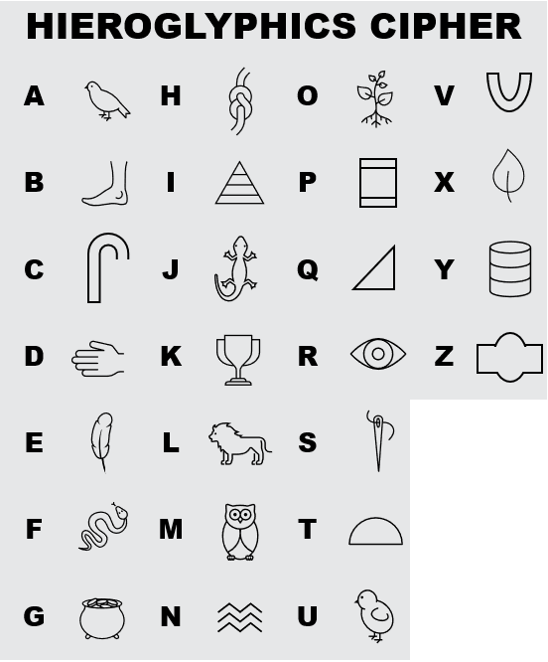
TASK 2
ANCIENT EGYPT
Ancient Egypt was one of the greatest civilizations in history. Experts do not completely agree on when it began. Most timelines begin around 3100 BC, when the kingdoms of Egypt were unified. The Ancient Egyptian civilization thrived until 332 BC, when it was conquered by the famous Macedonian warlord Alexander the Great (356 BC–323 BC). After this conquest, Ancient Egypt went into decline. Ancient Egypt is commonly remembered for its pyramids, mythology, mummies, and unique system of picture-writing known as hieroglyphs.
Directions: Use the hieroglyphics cipher tool to decode the clues. Answer the questions on your group answer key. Get approval of correct code before moving on to task 3.
24

Slide 25






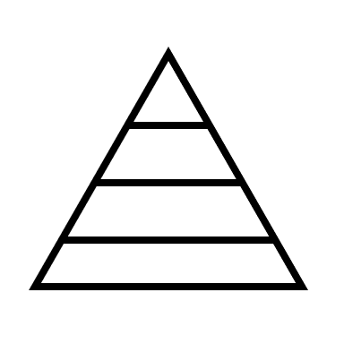










1. For most of its history, Ancient Egypt was ruled by ________, who were thought of as gods in human form.
2. Much of the civilization was based along the fertile plains of the _______________ River.
3. Most historians believe the ___________ were built to serve as tombs for the Pharaohs.
4. The bodies of important people were preserved after death so they would retain a lifelike appearance. This process was known as __________________.
5. The Great Pyramid at _________ is the largest pyramid and one of the Seven Wonders of the Ancient World.
6. Ancient Egypt went into decline after being conquered by _____________ the Great in 332 BC.
25

Slide 26
TASK 3
ANCIENT INDIA
Like Mesopotamia, Egypt, and China, ancient India was a place where one of the world’s first great civilizations was born. Ancient India was also one of the largest ancient civilizations, stretching across the entire Indian subcontinent, which includes all of what is known today as India, Pakistan, and Bangladesh. Even more importantly, the ancient Indian civilization that formed around the Indus River gave birth to many of India’s unique cultural traditions, such as the Hindu religion. Over the years, ancient India was also home to some of the world’s first and most powerful kingdoms, including the Maurya Empire and the Gupta Empire. India and Indian culture continued to grow and change long after these and other empires fell, and the influence of ancient India is still felt in many ways today.
Directions: Read the assigned resource on Ancient India. After reading, put the following events in Ancient India history in the correct order. Answer the questions on your group answer key. Get approval of correct code before moving on to task 4.
- - - - - - - - - - - - - - - - - - - - - - - - - - - - - - - - - - - - - - - - - - - - - - - - - - - - - - -
- - - - - - - - - - - - - - - - - - - - - - - - - - - - - - - - - - - - - - - - - - - - - - - - - - - - - - -
TASK 3
ANCIENT INDIA
Like Mesopotamia, Egypt, and China, ancient India was a place where one of the world’s first great civilizations was born. Ancient India was also one of the largest ancient civilizations, stretching across the entire Indian subcontinent, which includes all of what is known today as India, Pakistan, and Bangladesh. Even more importantly, the ancient Indian civilization that formed around the Indus River gave birth to many of India’s unique cultural traditions, such as the Hindu religion. Over the years, ancient India was also home to some of the world’s first and most powerful kingdoms, including the Maurya Empire and the Gupta Empire. India and Indian culture continued to grow and change long after these and other empires fell, and the influence of ancient India is still felt in many ways today.
Directions: Read the assigned resource on Ancient India. After reading, put the following events in Ancient India history in the correct order. Answer the below on your group answer key. Get approval of correct code before moving on to task 4.
26

Slide 27
Aryans made their way into the region starting the Vedic Period.
8
People who lived in Indus Valley villages learned to make metal tools and other goods that they traded.
3
An increasing number of religious reformers broke away from Hinduism to create other religions like Buddhism and Jainism.
5
The Indus Valley civilization was hit by a series of earthquakes that disrupted life there and may have forced many people to flee.
1
The Gupta Empire came to rise in 320 AD. During the Gupta Empire, India entered a golden era, during which the arts and sciences flourished.
4
Farmers first started growing crops near the banks of the Indus River
7
The caste system was implemented which divided ancient Indian society into four main classes—the Brahmin, Kshatriya, Vaisya, and Sudra castes.
2
The planned cities of Mohenjo-Daro and Harappa were formed.
6
27

Slide 28
TASK 4
ANCIENT CHINA
China is a large nation in eastern Asia with a history that dates back many thousands of years. The Chinese culture is one of the oldest in the world. Ancient humans began growing rice in China around 6000 BC and settled in farming villages around 5000 BC. Many of these early villages were in the Yellow River Valley in north-central China. In the 1950s, archaeologists discovered the remains of an ancient town called Banpo Village in northwestern China. People lived in more than one hundred houses in Banpo Village from about 4500 to 3750 BC. These early people also used stone tools and buried their dead.
Directions: Read the assigned resource on Ancient China. Use the information to answer the following multiple-choice questions. Answer the questions on your group answer key. Get approval of correct code before moving on to task 5.
- - - - - - - - - - - - - - - - - - - - - - - - - - - - - - - - - - - - - - - - - - - - - - - - - - - - - - -
TASK 4
ANCIENT CHINA
China is a large nation in eastern Asia with a history that dates back many thousands of years. The Chinese culture is one of the oldest in the world. Ancient humans began growing rice in China around 6000 BC and settled in farming villages around 5000 BC. Many of these early villages were in the Yellow River Valley in north-central China. In the 1950s, archaeologists discovered the remains of an ancient town called Banpo Village in northwestern China. People lived in more than one hundred houses in Banpo Village from about 4500 to 3750 BC. These early people also used stone tools and buried their dead.
Directions: Read the assigned resource on Ancient China. Use the information to answer the following multiple-choice questions. Answer the questions on your group answer key. Get approval of correct code before moving on to task 5.
28

Slide 29
1.China is named after which dynasty?
Qin c. Song
b. Zhou d. Yuan
2. The 1987 movie The Last Emperor was based on the life of which Chinese emperor?
l. Huangdi n. Puyi
m. Zhou o. Qing
3. Who was said to have invented the Chinese calendar and Chinese writing?
Han c. Huangdi
b. Qing d. Zheng
4. What was the name of the great royal palace built during the Ming dynasty?
h. The Great Wall j. Beijing
i. The Forbidden City k. The Golden Gate
5. China became the richest nation on Earth during which period?
e. The Golden Age g. The Warring States
f. The Ten Kingdoms h. The Three Kingdoms
6. The Chinese developed an idea that the country’s kings were the “sons” of heaven. Events were treated as a sign the gods were either pleased or unhappy with the king. What was this known as?
l. Divine Intervention n. Mandate of Heaven
m. A dynasty o. The Golden Age
7. During which time did China begin to do away with slavery and change to a system of landowners and servants.?
r. Tang t. Zhou
s. Sui u. Song
29

Slide 30
TASK 5
ANCIENT ISRAEL
One of the world’s oldest civilizations, Ancient Israel existed more than four thousand years ago. The people who lived in ancient Israel were called Israelites, and they were unique at the time because they were monotheistic.
Directions: Read the assigned resource on Ancient Israel. Using the information from the reading, complete the crossword puzzle. Highlighted boxes will reveal code. Record code on group answer sheet and get approval before moving on to task 6.
- - - - - - - - - - - - - - - - - - - - - - - - - - - - - - - - - - - - - - - - - - - - - - - - - - - - - - -
TASK 5
ANCIENT ISRAEL
One of the world’s oldest civilizations, Ancient Israel existed more than four thousand years ago. The people who lived in ancient Israel were called Israelites, and they were unique at the time because they were monotheistic.
Directions: Read the assigned resource on Ancient Israel. Using the information from the reading, complete the crossword puzzle. Highlighted boxes will reveal code. Record code on group answer sheet and get approval before moving on to task 6.
30

Slide 31
Down:
1. King David rose to power, and under his rule, the Israelites conquered and made this place their capital city
2. this group created the state of Israel in 1948
5. Israel remained a province of ___________for about two hundred years
7. In scripture, Moses went to Egyptian Pharaoh Ramses II to plead for freedom for the Israelites, but he was always denied. This led God to send the Egyptians ten terrible __________
10. the __________ forced the Jews into slavery
12. This person was the founder of the Jewish people and believed in one God
Across:
3. The worship of idols caused Israel to divide into two countries: ________ in the south and Israel in the north.
4. In 334 BC, Alexander the Great conquered the Persian empire and Israel became a province of __________
6. Israel is a small nation about the size of this state
8. Much of ancient Israel’s early history is intertwined with ________
9. Israel was conquered by the ___________ in 722 BC
11. When defeated by this empire the Israelites were exiled
31

Slide 32
TASK 6
ANCIENT GREECE
Few civilizations in history ever had as great an impact on human society as ancient Greece. Many of the ideas that played a key role in the development of the modern world first came from, or were greatly advanced by, the ancient Greeks. Some of these include philosophy (the study of the nature of knowledge, reality, and existence), democracy (government ruled by the people), and mathematics. The history of ancient Greece is divided into three different eras: the Archaic age (700–480 BC), Classical age (480–323 BC), and the Hellenistic age (323–30 BC). In just this short period, however, ancient Greece forever changed the world and set the stage for the future of all humankind.
Directions: Access the Gale in Context: Middle School images section of the topic page on Ancient Greece. Using the information there, match the image to the correct description. Matches will reveal your code. Record code on group answer sheet and get approval before moving on to task 7.
- - - - - - - - - - - - - - - - - - - - - - - - - - - - - - - - - - - - - - - - - - - - - - - - - - - - - - -
TASK 6
ANCIENT GREECE
Few civilizations in history ever had as great an impact on human society as ancient Greece. Many of the ideas that played a key role in the development of the modern world first came from, or were greatly advanced by, the ancient Greeks. Some of these include philosophy (the study of the nature of knowledge, reality, and existence), democracy (government ruled by the people), and mathematics. The history of ancient Greece is divided into three different eras: the Archaic age (700–480 BC), Classical age (480–323 BC), and the Hellenistic age (323–30 BC). In just this short period, however, ancient Greece forever changed the world and set the stage for the future of all humankind.
Directions: Access the Gale in Context: Middle School images section of the topic page on Ancient Greece. Using the information there, match the image to the correct description. Matches will reveal your code. Record code on group answer sheet and get approval before moving on to task 7.
32

Slide 33
1
2
3
4
5
6
33

Slide 34
7
8
Medusa
Frieze
The
Acropolis
H
D
Temple
of Athena
The
Parthenon
C
G
The
Agora
Temple
of Apollo
B
F
Porch of
the
Caryatids
Ruins at
Delos
A
E
34

Slide 35
TASK 7
ANCIENT ROME
Ancient Rome refers to a period of Roman history that lasted between the eighth century BC and the fifth century AD. Ancient Rome went through many political changes during this time. It went from a kingdom to a republic to an empire. The city of Rome, located on the Italian Peninsula, was the center of ancient activity. Over the centuries, the Roman Empire became one of the largest empires in the world. At its peak, it had an estimated fifty million to ninety million citizens. Ancient Roman thought and practices influenced modern society in many ways. These contributed to law, politics, architecture, art, language and many other ideas.
Directions: Read the assigned biography on Roman leader, Julius Caesar. Use the biography information to complete his profile page. Your code will be the quote, which you will decode using the pigpen cipher. Record code on group answer sheet and get approval before moving on to task 8.
- - - - - - - - - - - - - - - - - - - - - - - - - - - - - - - - - - - - - - - - - - - - - - - - - - - - - - -
TASK 7
ANCIENT ROME
Ancient Rome refers to a period of Roman history that lasted between the eighth century BC and the fifth century AD. Ancient Rome went through many political changes during this time. It went from a kingdom to a republic to an empire. The city of Rome, located on the Italian Peninsula, was the center of ancient activity. Over the centuries, the Roman Empire became one of the largest empires in the world. At its peak, it had an estimated fifty million to ninety million citizens. Ancient Roman thought and practices influenced modern society in many ways. These contributed to law, politics, architecture, art, language and many other ideas.
Directions: Read the assigned biography on Roman leader, Julius Caesar. Use the biography information to complete his profile page. Your code will be the quote, which you will decode using the pigpen cipher. Record code on group answer sheet and get approval before moving on to task 8.
35

Slide 36
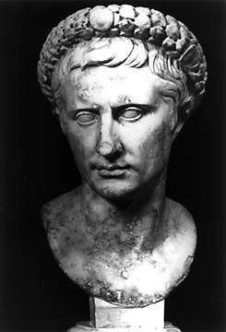
JULIUS CAESAR
Birth Date:
Death Date:
Cause of Death:
Political Party:
Title at Time of Death:
Father’s Name and Position:
Mother’s Name:
Partners’ Names: 1. 2. 3.
Jobs/Positions: 1. 2. 3. 4. 5.
Noteworthy Accomplishments: 1. 2. 3.
Famous Quote: (Use the Pigpen Cipher to decode)
36

Slide 37
PIGPEN CIPHER
- - - - - - - - - - - - - - - - - - - - - - - - - - - - - - - - - - - - - - - - - - - - - - - - - - - - - - -
PIGPEN CIPHER
37

Slide 38
TASK 8
ANCIENT AFRICA
Ancient Africa was home to the first humans who evolved from apelike creatures that roamed the continent millions of years ago. Over time, many early human ancestors migrated away from Africa to other parts of the world. At first, those who stayed were hunter-gatherers who lived in small, nomadic groups. Thousands of years ago, civilizations began to develop in northern Africa. One of the largest and most famous was the ancient Egyptian civilization. During the past two thousand years, several other civilizations developed in Africa. Many of these kingdoms became very powerful and controlled important regions of the continent.
Directions: Read the assigned resource on Ancient Africa. Use the information to match each part of the question with its answer by drawing a line to connect them. At the end, the letters with no line through them will reveal your code. Record your code to finally escape! Tip – use a ruler to get extra straight lines!
- - - - - - - - - - - - - - - - - - - - - - - - - - - - - - - - - - - - - - - - - - - - - - - - - - - - - - -
TASK 8
ANCIENT AFRICA
Ancient Africa was home to the first humans who evolved from apelike creatures that roamed the continent millions of years ago. Over time, many early human ancestors migrated away from Africa to other parts of the world. At first, those who stayed were hunter-gatherers who lived in small, nomadic groups. Thousands of years ago, civilizations began to develop in northern Africa. One of the largest and most famous was the ancient Egyptian civilization. During the past two thousand years, several other civilizations developed in Africa. Many of these kingdoms became very powerful and controlled important regions of the continent.
Directions: Read the assigned resource on Ancient Africa. Use the information to match each part of the question with its answer by drawing a line to connect them. At the end, the letters with no line through them will reveal your code. Record your code to finally escape! Tip – use a ruler to get extra straight lines!
38

Slide 39
TASK 8
ANCIENT AFRICA
Correctly match each question with its answer by drawing a line to connect them (use the dots!). At the end, the letters with no line through them will reveal your code.
Tip – use a ruler to get extra straight lines!
Sundiata Keita | • |  | • | This region was created after a climate change in northern Africa
Carthage | • |  | • | People could stay in one place instead of being nomadic
Epic of Sundiata | • |  | • | One of the first kingdoms in the world to accept the religion of Christianity
The Sahara Desert | • |  | • | Known as the Lion King
Aksum | • |  | • | A powerful civilization with its capital city in modern-day Tunisia.
Domestication of Animals | • |  | • | One of the oldest-known works of African literature
S
G
H
C
E
A
O
Y
N
S
A
R
39

Slide 40
CITATION INFORMATION
TASK 1
"Mesopotamia." Gale Middle School Online Collection, Gale, 2021. Gale In Context: Middle
School, link.gale.com/apps/doc/YTKUHM055839591/MSIC?u=[LocationID]&sid= bookmark-MSIC&xid=1012b834. Accessed 27 Sept. 2022.
TASK 2
"Ancient Egypt." Gale Middle School Online Collection, Gale, 2021. Gale In Context: MiddleSchool, link.gale.com/apps/doc/YMQNAY144176332/MSIC?u=[LocationID] &sid=bookmark-MSIC&xid=9473c4c9. Accessed 27 Sept. 2022.
TASK 3
"Ancient India." Gale Middle School Online Collection, Gale, 2021. Gale In Context: Middle School, link.gale.com/apps/doc/OYXFIO592699449/MSIC?u=[LocationID]& sid=bookmark-MSIC&xid=37206ea2. Accessed 27 Sept. 2022.
TASK 4
"Ancient China." Gale Middle School Online Collection, Gale, 2021. Gale In Context: MiddleSchool, link.gale.com/apps/doc/EBBFLB574881541/MSIC?u=[LocationID]& sid=bookmark-MSIC&xid=9356d9b3. Accessed 27 Sept. 2022.
TASK 5
"Ancient Israel and the Israelites." Gale Middle School Online Collection, Gale, 2021. Gale InContext:MiddleSchool, link.gale.com/apps/doc/WZPTUB069829912/MSIC? u=[LocationID]&sid=bookmark-MSIC&xid=b5ed88cd. Accessed 28 Sept. 2022.
TASK 6
"Ancient Greece." Gale Middle School Online Collection, Gale, 2021. Gale In Context: MiddleSchool,link.gale.com/apps/doc/ZWNSXN165560554/MSIC? u=[LocationID]& sid=bookmark-MSIC&xid=c2dd5376. Accessed 28 Sept. 2022.
TASK 7
"Julius Caesar." Gale Middle School Online Collection, Gale, 2022. Gale In Context: MiddleSchool, link.gale.com/apps/doc/JRXCFF963155011/MSIC? u=[LocationID]& sid=bookmark-MSIC&xid=31838d3a. Accessed 29 Sept. 2022.
TASK 8
"Ancient Africa." Gale Middle School Online Collection, Gale, 2021. Gale In Context:MiddleSchool,link.gale.com/apps/doc/ZQQYHS680445161/MSIC? u=[LocationID]&sid=bookmark-MSIC&xid=0bb00834. Accessed 29 Sept. 2022.
EXPLORE MORE!
Find more classroom resources and support materials at:
support.gale.com
40

